Slide 1
CART Algorithm - Regressor

Slide 2

Splits data into two parts at each node (binary split)
Chooses splits that minimize prediction error
Predicts the mean value of the target in each leaf
Split criterion:
Variance(Mean Squared Error (MSE))
Other options- RSS,SD

Slide 3
Split data to reduce variance
Choose split with minimum weighted MSE
Leaf node prediction = mean of target values
Top-down, greedy algorithm

Slide 4
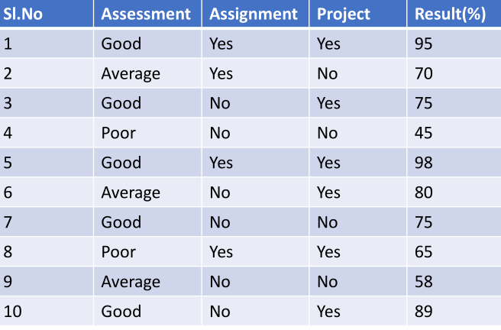

Slide 5
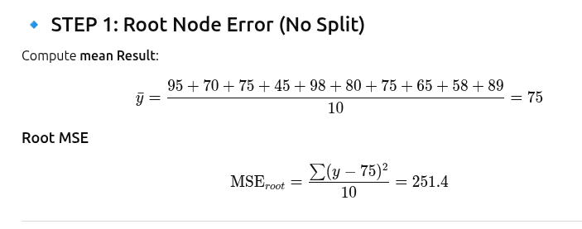

Slide 6
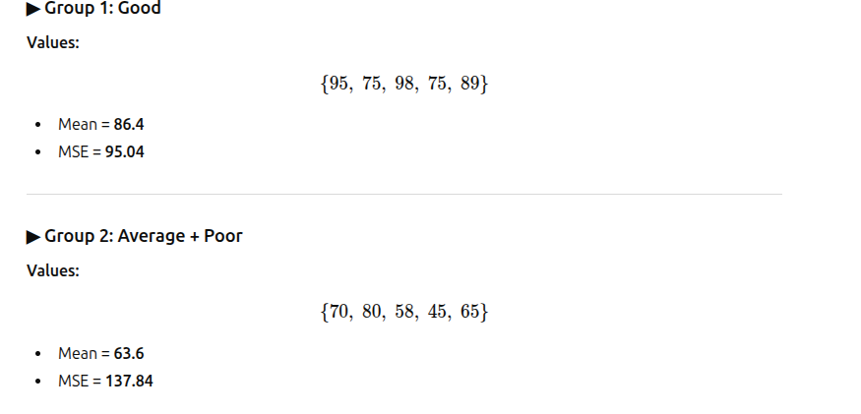

For 3 categories, unique binary splits are: {Good} vs {Average, Poor}
Split: {Good} vs {Average, Poor}

Slide 7
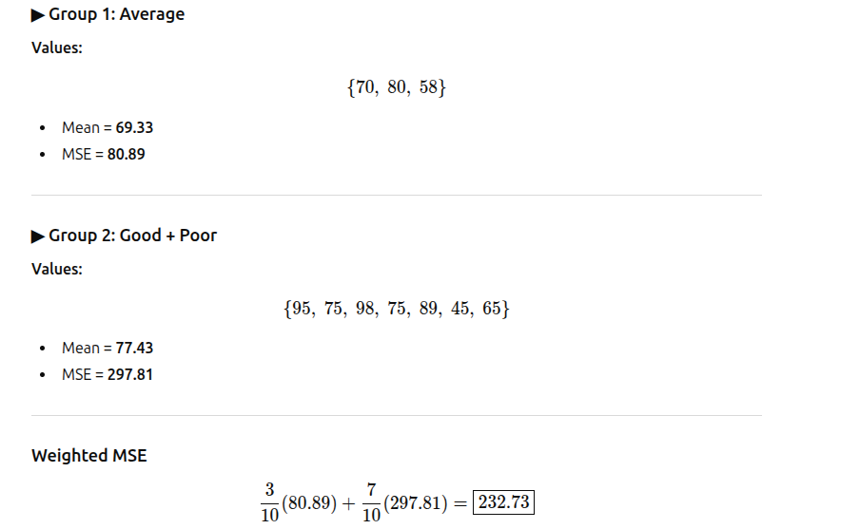
{Average} vs {Good, Poor}

Slide 8
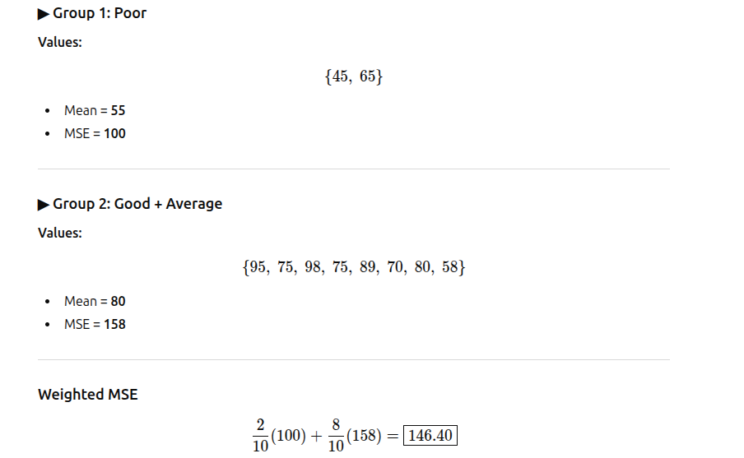
{Poor} vs {Good, Average}

Slide 9
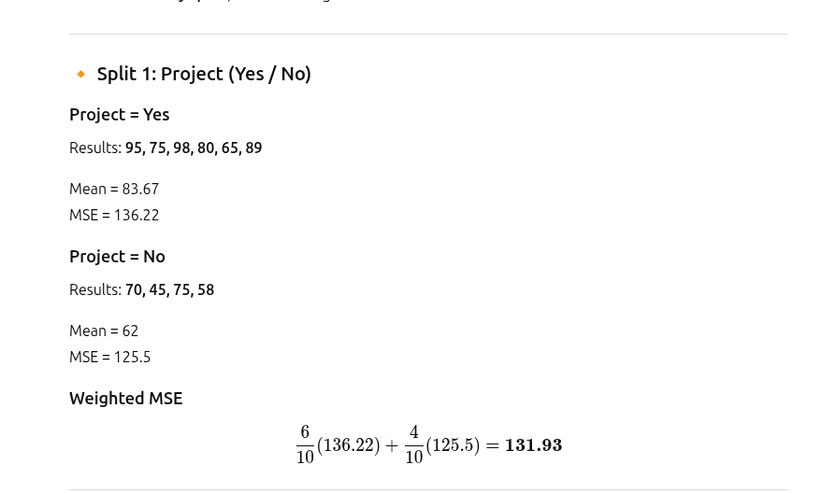

Slide 10
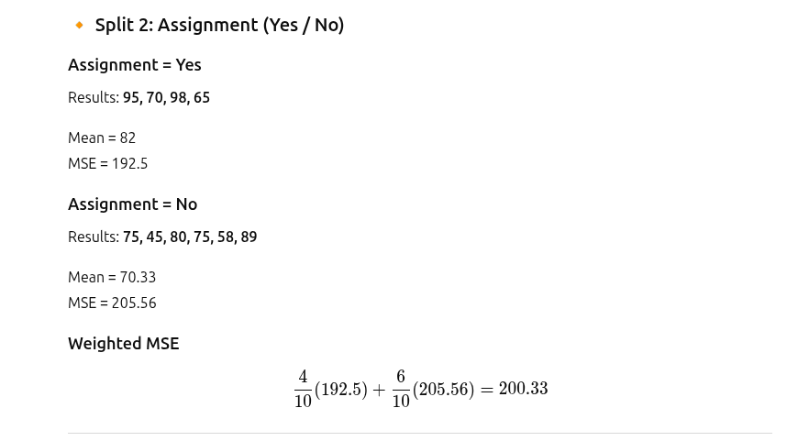

Slide 11
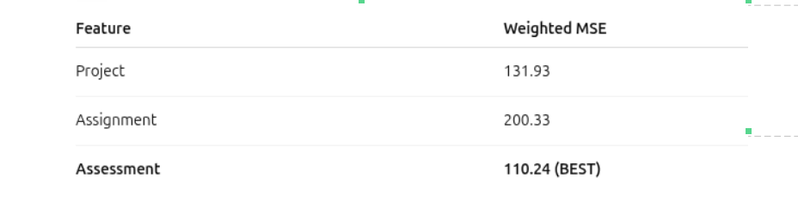
Assessment
┌────────┴────────┐
Good Average / Poor

Slide 12
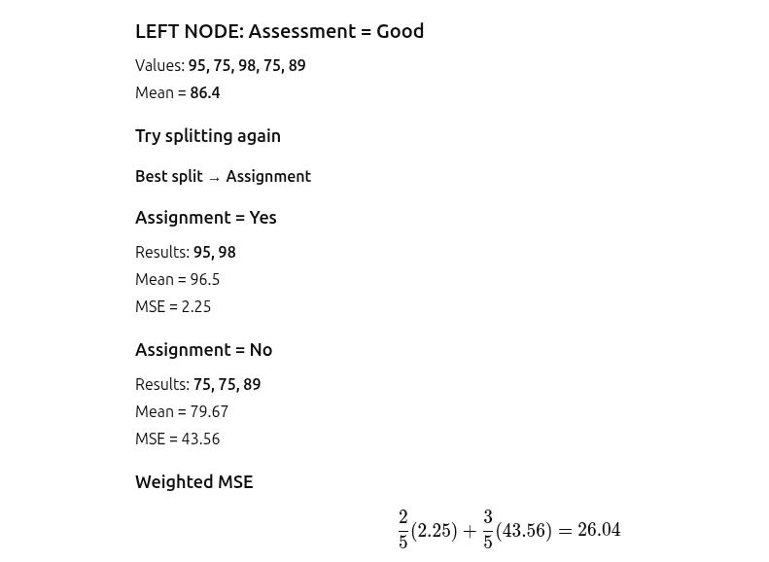

Slide 13
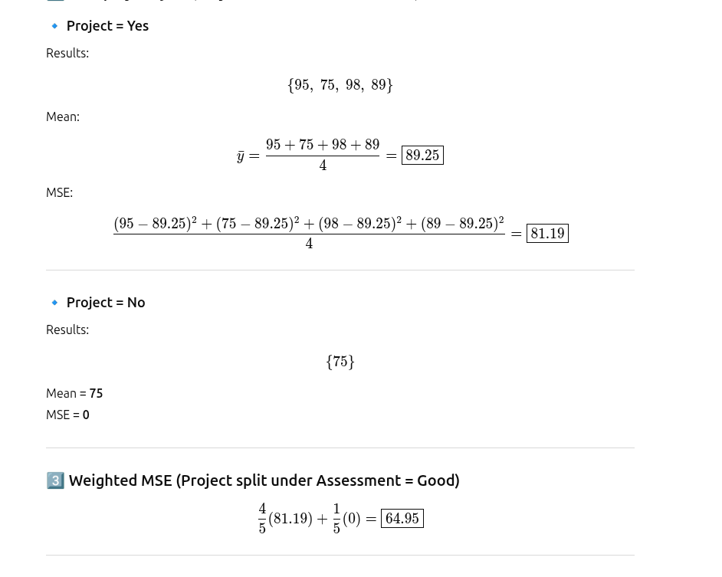

Slide 14
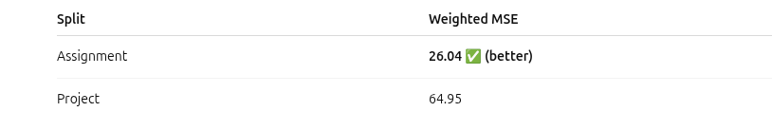

Slide 15
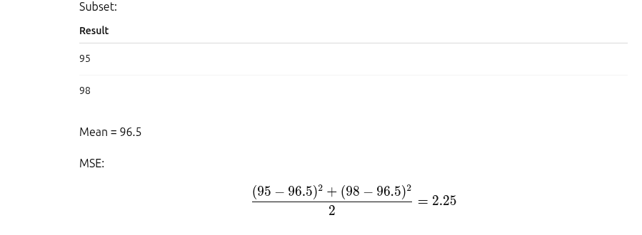
Assessment = Good AND Assignment = Yes
Remaining feature: Project
But both records have:
Project = Yes
So split gives no separation.

Slide 16
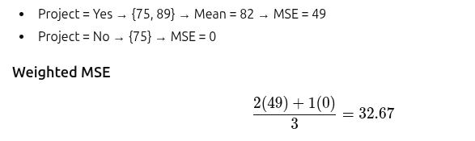
Assessment=Good, Assignment=No
Error reduction is small with respect to parent. So treated as leaf node.

Slide 17
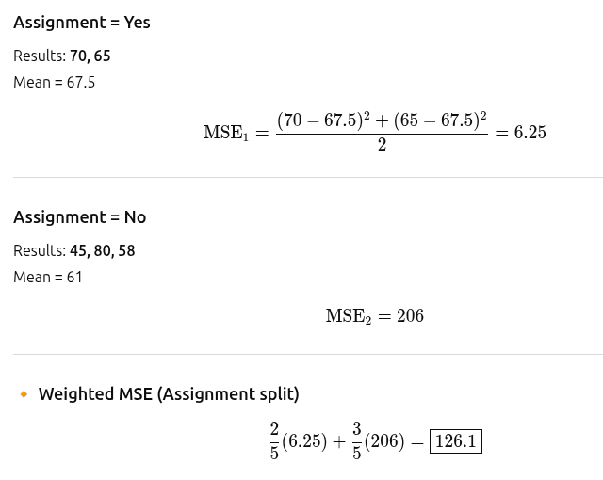
Right subtree = Assessment = Average / Poor
MSE2=208.6 approx
WMSE= 128 appro

Slide 18
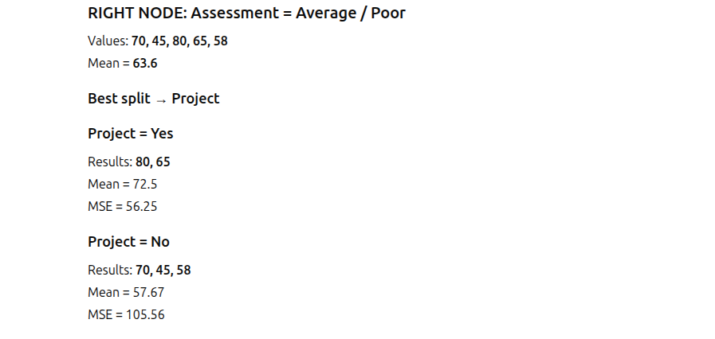
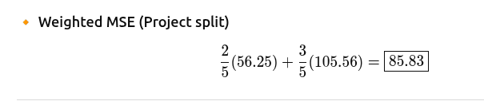
85.03(approx)

Slide 19
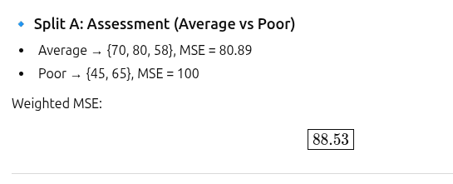
Assessment= Average and Poor
MSE: Average=81.66, Poor=100,
WMSE= 88.9 (app)

Slide 20
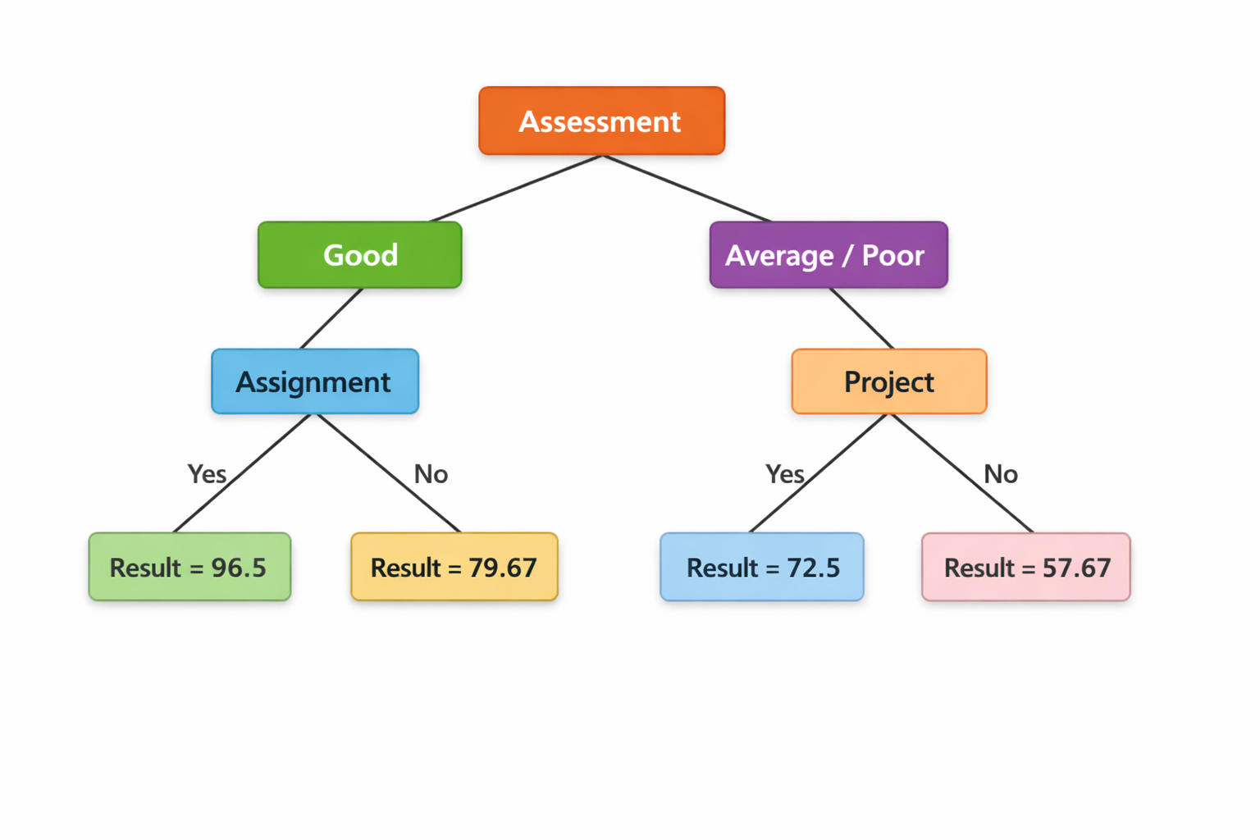
Final Tree

